Slide 1
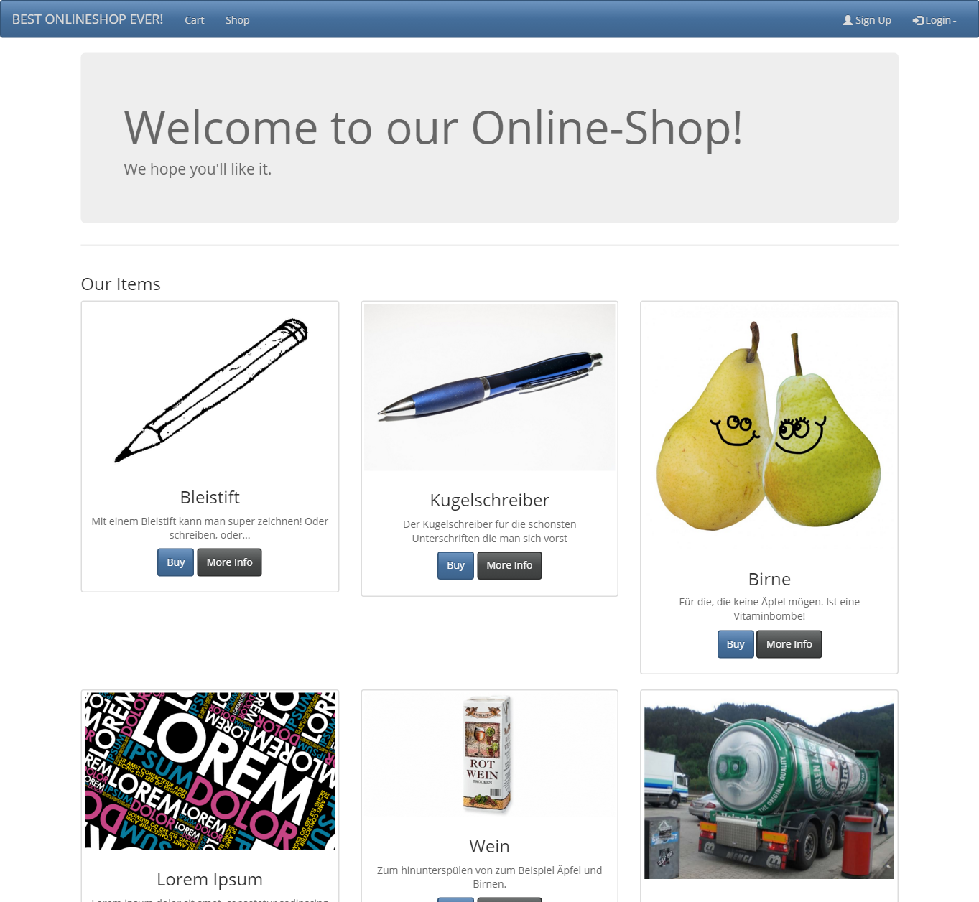
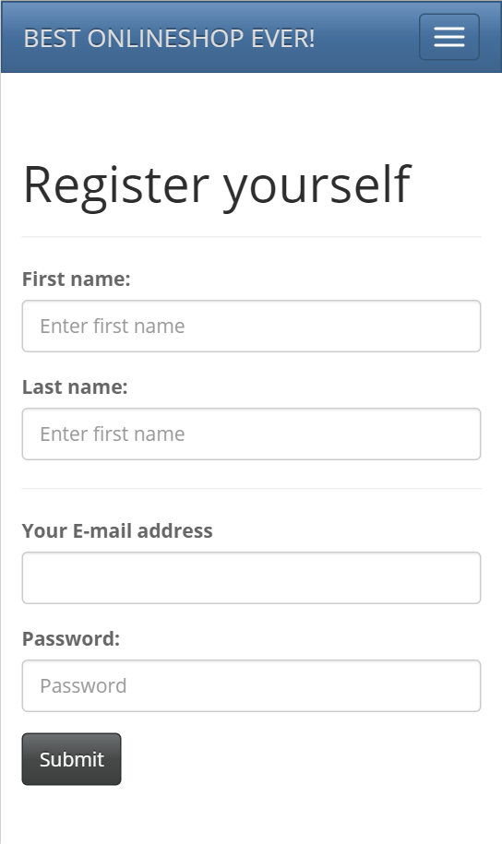
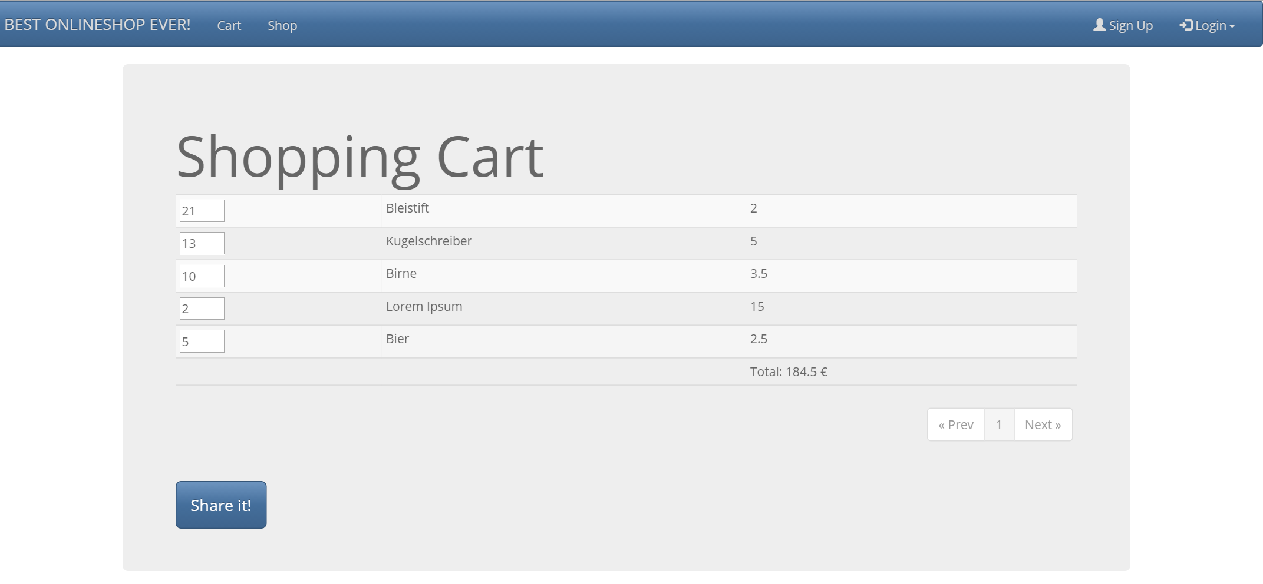
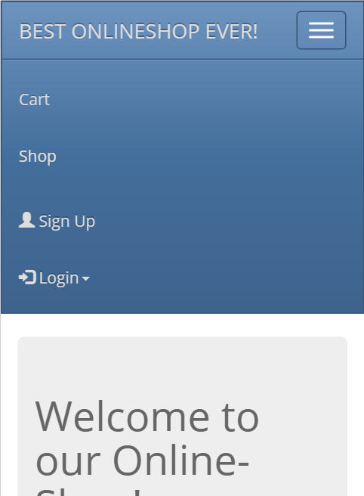
Webshop
Software Design (SWD14)
Shop – Choose Items to buy
User registration and login
Cart – View your Items, and modify quantity or delete them
Sharable by link
Fully responsive

